Slide 1

SmartShopper
Andres Uriegas, Anthony Tomsio, Tien Quang, Kevin Chen, Palak Sharma

Slide 2


Objective
In the beginning there was nothing, then there was light.
Now billions of years later, there is SmartShopper.
Here to revolutionize the way you shop!

Slide 3
Cost Estimations
Estimated Cost of Hardware Products
Smart Phone (Android) - $700 [3]
Estimated Cost of Software Products
Firebase - $25/month (Flame subscription) [2]
Estimated Cost of Personnel
Lead Software Engineer - $100,000/yr [1]
Database Administrator - $75,000 [1]
Testing Engineer - $50,000/yr [1]
QA Engineer - $45,000/yr [1]
UX Designer - $43,000/yr [1]

Slide 4
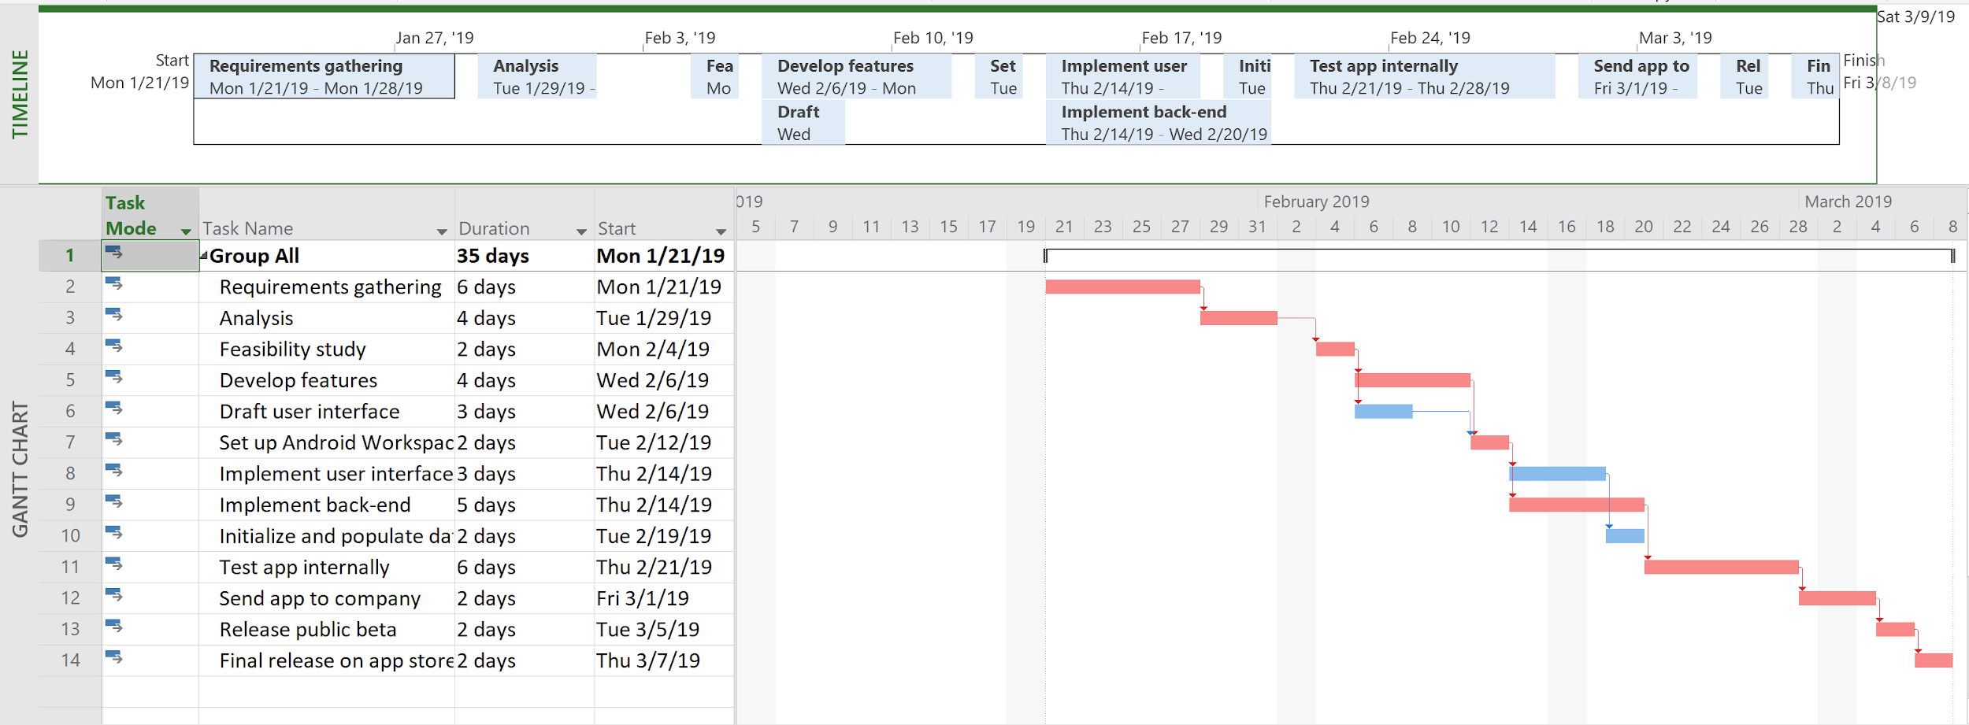
Project Timeline

Slide 5
Functional Requirements
Get grocery list from user, look through products in the store through a database
Find best-fit-route based off of an algorithm such as Kruskal’s
Authenticate user logins using the database
Display store map to the user
Data for each of the products can be modified by the users (crowdsourcing)

Slide 6
Nonfunctional Requirements
Product requirements
User-Friendly
Offline mode for spotty store connection
Don’t let unauthorized users access database
Organizational requirements
App, interpretation of data on a smartphone
Database in a Google Cloud server
External requirements
Ensure that user’s privacy is respected
Report general app statistics and usage data

Slide 7
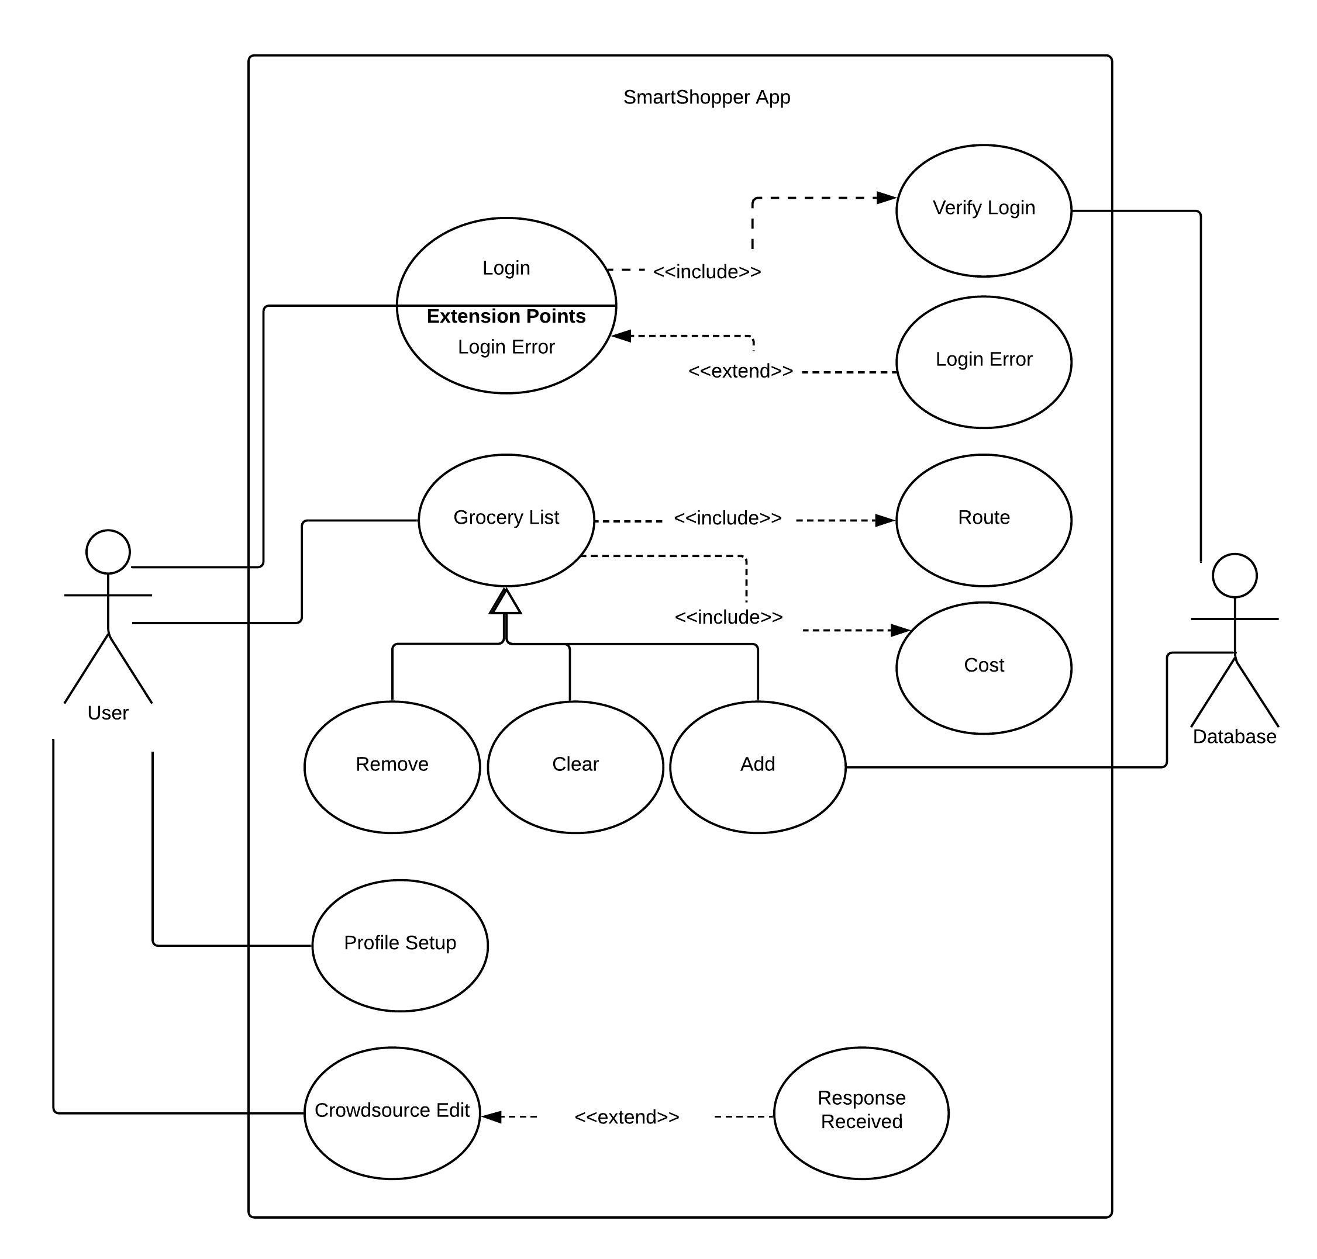
Use Case Diagram

Slide 8
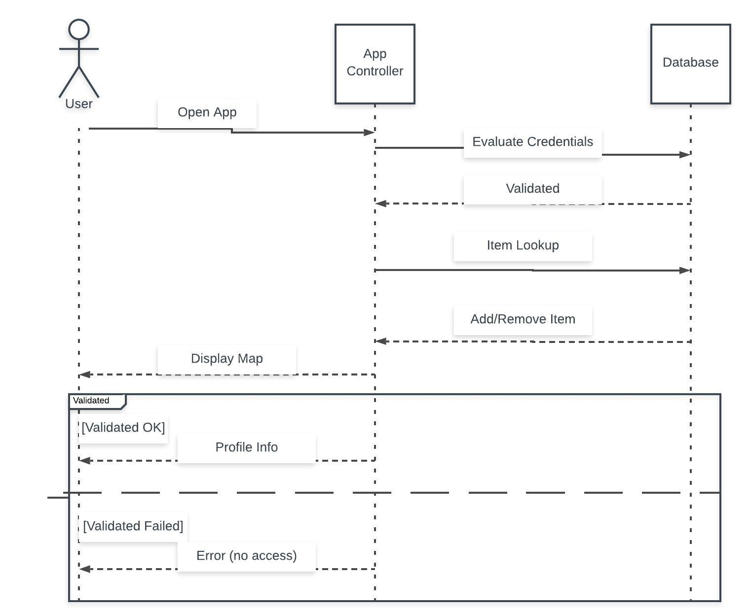
Sequence Diagram

Slide 9
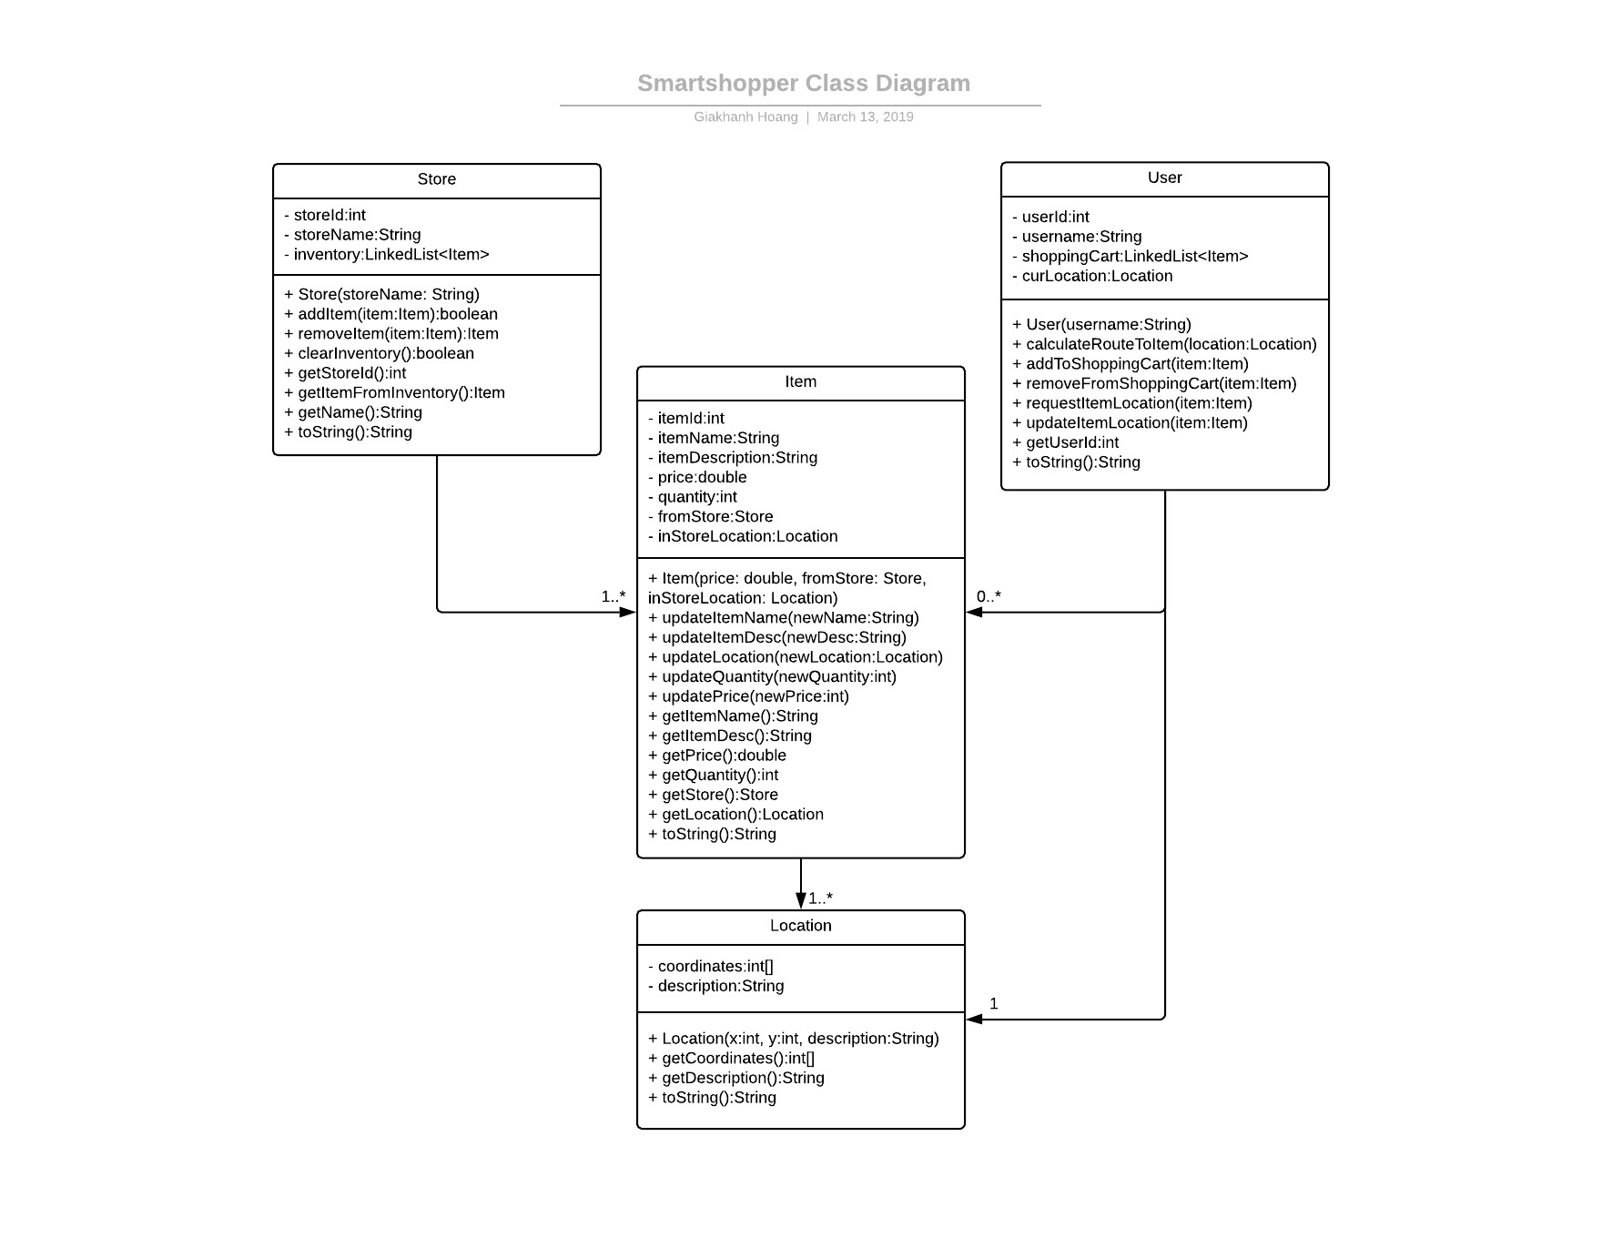
Class Diagram

Slide 10
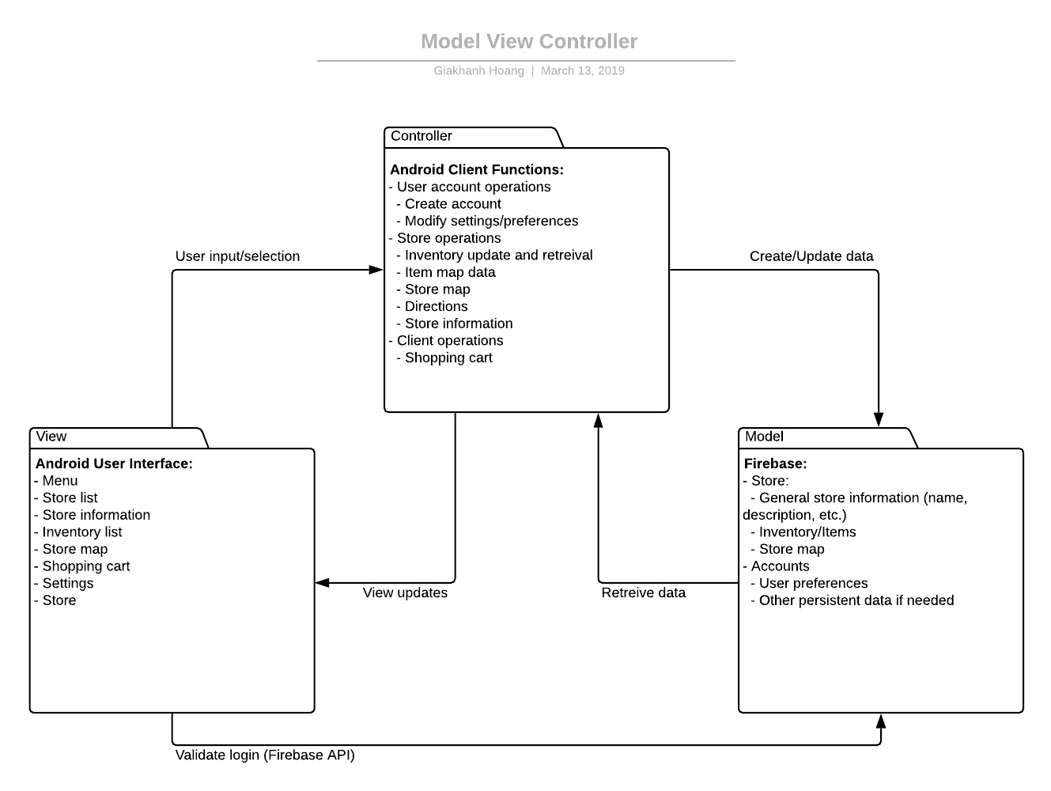
Architectural Diagram (MVC)

Slide 11
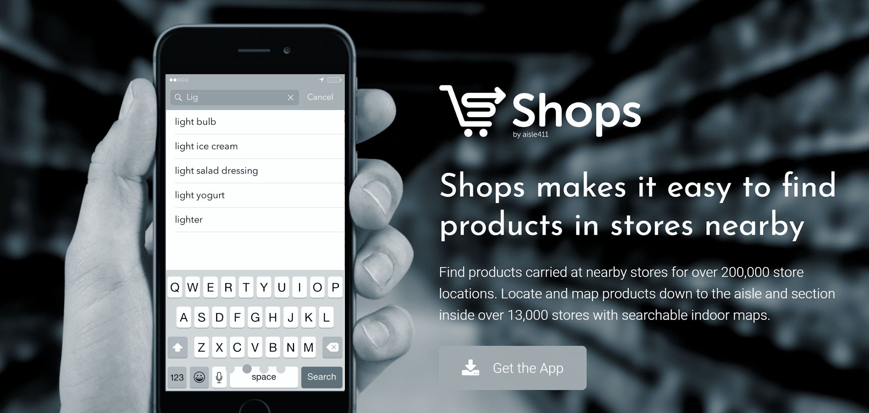
Why use SmartShopper?
Source: https://www.aisle411.com/shops/

Slide 12

Why use SmartShopper?
Crowdsourcing
Source: https://www.sciencemag.org/careers/2018/02/crowdsourcing-goes-academic-platforms-reviewing-advisers

Slide 13








UI Design
Smartshopper
Smartshopper
Home
🔍 Search...
🔍 Search...
View Map
Advertisements
Advertisements
Stores
Your Profile
Make Edits
Shop by Category
Shop by Category
Sign out

Slide 14
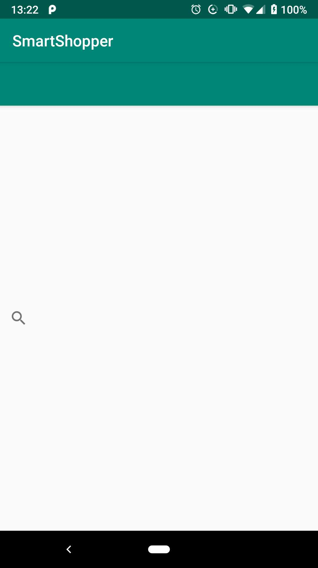
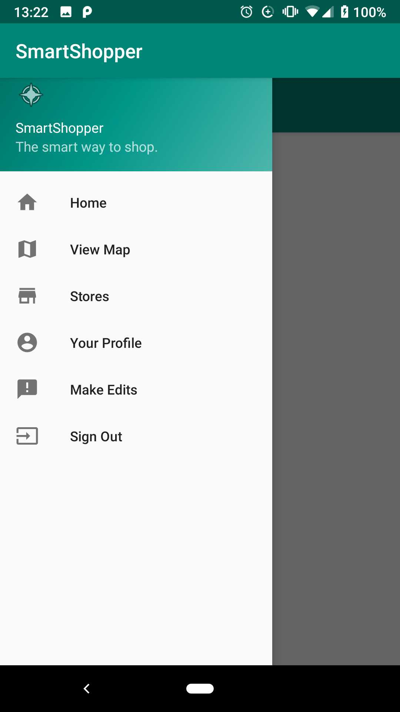
UI Design

Slide 15
Any Questions?

Slide 16
References
[1] “Search Job Salaries,” PayScale, 01-Jan-2019. [Online]. Available: https://www.payscale.com/research/US/Job. [Accessed: 17-Apr-2019].
[2] “Pricing Plans,” Firebase. [Online]. Available: https://firebase.google.com/pricing/. [Accessed: 19-Apr-2019].
[3] M. Spoonauer, “Galaxy S9 and S9 Review,” Tom's Guide, 25-Feb-2019. [Online]. Available: https://www.tomsguide.com/us/galaxy-s9-s9-plus,review-5198.html. [Accessed: 19-Apr-2019].
[4] Aisle411. [Online]. Available: http://aisle411.com/. [Accessed: 19-Apr-2019].
[5] K. Müller, “How crowdsourcing is changing the Waze we drive,” Technology and Operations Management. [Online]. Available: https://rctom.hbs.org/submission/how-crowdsourcing-is-changing-the-waze-we-drive/. [Accessed: 19-Apr-2019].

